Slide 1

Power and Authority
Hasan Muhammad Baniamin

Slide 2
Power
Power can be defined as the ability to influence the behaviour of another.
Power brings about compliance through persuasion, threats, coercion or violence.

Slide 3


Slide 4
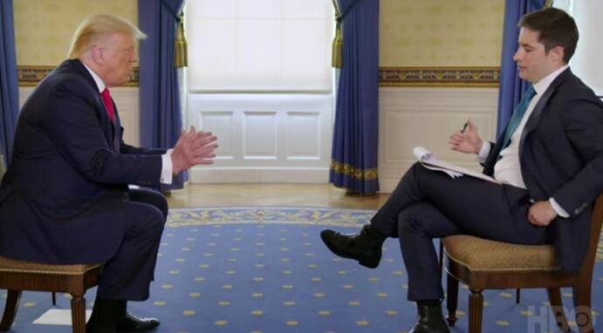
What do you think about this picture?

Slide 5
Faces of power
Stephen Lukes said Sociologists should study power as having 3 “faces”.
The first face/Overt dimension-decision making
  This is based upon the work of Dahl who said that person who wins and argument, or an issue, has the power. This fits with the Classical Pluralist approach to power. For example: a parent wins an argument with their child, so they have the power.

Slide 6
Faces of power
The second face/covered dimension-decision making & non-decision making
  Power is activated on the second, not only in order to triumph over the other participants in the decision-making process, but also to prevent decision-making, to exclude certain subjects or participants from the process

Slide 7
Faces of power
The third face/latent dimension – Manipulating the view of others
  The third face of power described how power can covert manipulate others to do something they might not actually want to do by changing what they want.
  Lukes, Marxist, said this can create a false consciousness as the working class will be convinced that what the ruling class want is actually what they want too.

Slide 8
Authority
Authority and power are separate but closely related concepts.
Authority is the right to act or rule. Authority lies with the formal position and whoever occupies it shall exercise and issue orders and commands.
According to Max Weber, “ Authority is the willing and unconditional compliance of people, resting upon their belief that it is legitimate for the superior to impose his will on them and illegitimate for them to refuse to obey.”
Thus compared to power, authority is characterized by legitimacy.
Power + Legitimacy = Authority

Slide 9
Types of authority
The German sociologists Max Weber classified authority into three types:
  Traditional authority
  Charismatic authority
  Legal- rational Authority

Slide 10
Traditional authority
In traditional authority, the dominant person or group, usually defined by heredity, is thought to have been preordained to rule over the rest.
This type of authority is based on customs, usages and precedents. People obey because the tradition of the customs dictates, they must do so.

Slide 11
Charismatic authority
This type of authority is based on exceptional personal traits of the ruler.
Here leaders are obeyed because they inspire their followers, who credit their heroes with exceptional and sometimes supernatural qualities.
Charismatic leaders are inspiring figures who emerge in times of crisis, and upheaval.
A significant feature of the charismatic authority system is that it is unstable, it breaks down when the leader dies or when the charismatic qualities of the leader declines.

Slide 12
Legal- rational Authority
It is based on laws, rules and regulations.
This system is called legal because authority is exercised by means of a system of rules and procedures.
It is called rational because in it the means are expressly designed to achieve certain specific ends. It means that obedience is owed not to an individual but to a set of principles.
Modern bureaucracies are the best example of this type of authority. We obey laws not just from fear, nor from tradition, nor from personal allegiance to the chief of police, but because we feel law and order is necessary and desirable in a rational society.

Slide 13
Suggested readings
Andrew, H., 2004. Political Theory An Introduction. PALGRAVE MACMILLAN, pp-121-151.

Slide 14
Q?

